Slide 1

Department of BES-II
BASIC ELECTRICAL & ELCTRONIC CIRCUITS (BEC)
COURSE CODE : 23EC1201
Topic: REAL, APPARENT, REACTIVE, POWER FACTOR, Steady state analysis of r, l, c circuits
Session – No. 6

Slide 2



AIM OF THE SESSION
The aim of this session is to discuss Real Power, Apparent Power, Reactive Power, and the role of the Power factor in Electrical Systems through suitable definitions of the various powers involved.
To familiarize students with the basic concept of steady state analysis of R,L,C circuits.
INSTRUCTIONAL OBJECTIVES
This Session is designed to:
Demonstrate the basic definitions for Real Power, Apparent Power, Reactive Power, Power Factor.
Students learn how to analyze and predict the behaviour of electrical circuits containing resistors, inductors, and capacitors. This is crucial for designing and troubleshooting electronic circuits.Describe
Studying RLC circuits helps students understand the phase relationships between voltage and current in different circuit elements. This knowledge is vital in various applications, including power factor correction and control systems.
LEARNING OUTCOMES
At the end of this session, you should be able to:
Understanding the concepts of Real Power, Apparent Power, Reactive Power, and Power Factor.
Students who master steady-state analysis of RLC circuits develop the ability to design electronic circuits that meet specific performance criteria.
The knowledge gained from studying steady-state analysis equips students with the skills to troubleshoot and debug electronic circuits effectively.

Slide 3
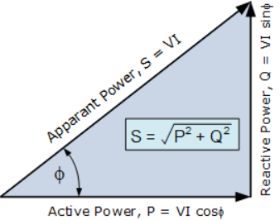
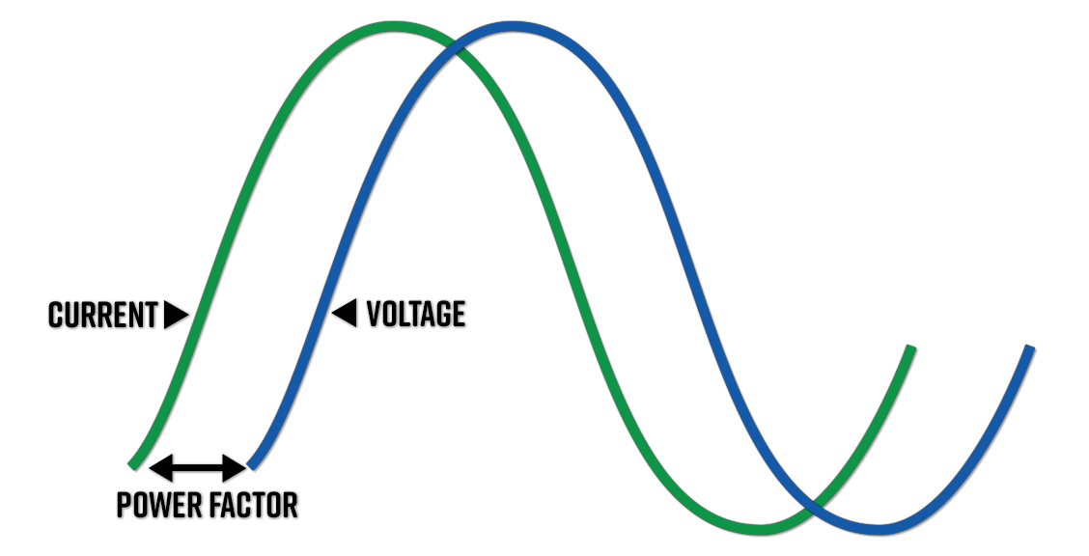
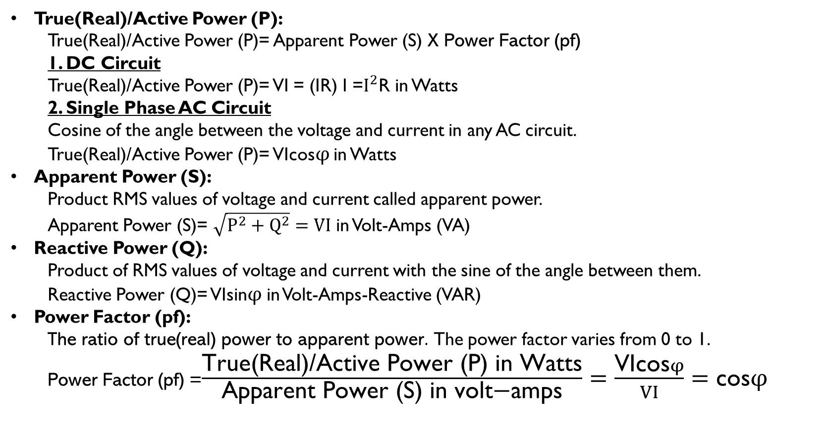
Real Power, Apparent Power, Reactive Power, Power Factor
True(Real)/Active Power (P):
  True(Real)/Active Power (P)= Apparent Power (S) X Power Factor (pf)
  1. DC Circuit
  True(Real)/Active Power (P)= VI = (IR) I =$I^{2}$R in Watts
  2. Single Phase AC Circuit
  Cosine of the angle between the voltage and current in any AC circuit.
  True(Real)/Active Power (P)= VIcos$φ$ in Watts
Apparent Power (S):
  Product RMS values of voltage and current called apparent power.
  Apparent Power (S)= $\sqrt{P^{2}+Q^{2}}=VI$ in Volt-Amps (VA)
Reactive Power (Q):
  Product of RMS values of voltage and current with the sine of the angle between them.
  Reactive Power (Q)= VIsin$φ$ in Volt-Amps-Reactive (VAR)
Power Factor (pf):
The ratio of true(real) power to apparent power. The power factor varies from 0 to 1.
Power Factor (pf) =$\frac{\text{True}\text{(}\text{Real}\text{)/}\text{Active} \text{Power}\text{ (}\text{P}\text{) }\text{in} \text{Watts}}{\text{Apparent} \text{Power}\text{ (}\text{S}\text{) }\text{in} \text{volt}\text{−}\text{amps}}=\frac{\text{VIcos}φ}{VI}=\text{cos}φ$

Slide 4
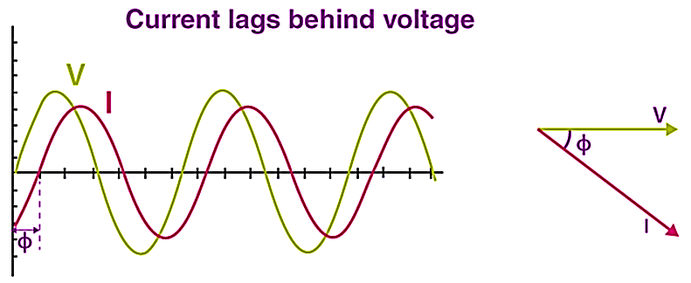
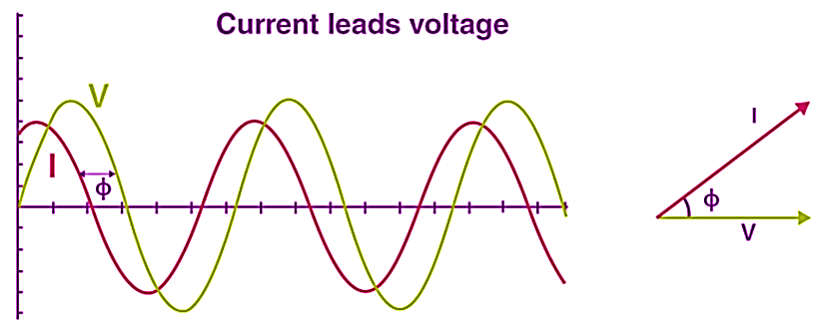
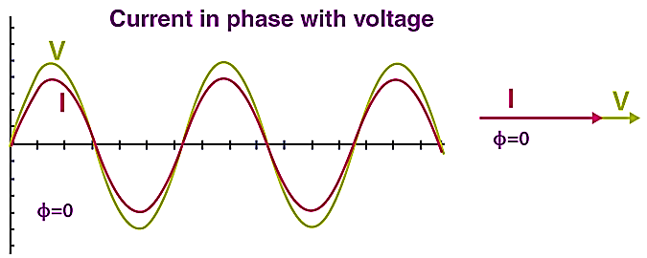

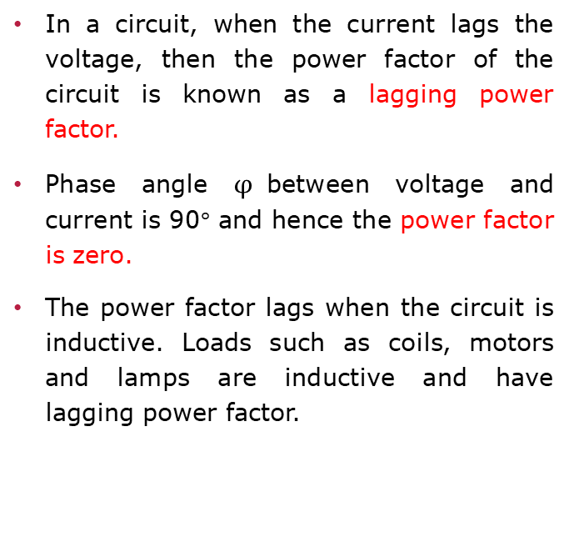
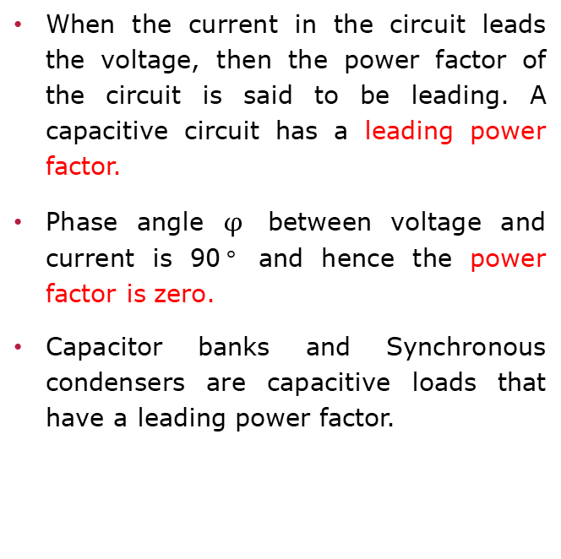
POWER FACTOR
Lagging (Inductor)
Leading (Capacitor)
Unity
In a circuit, when the current lags the voltage, then the power factor of the circuit is known as a lagging power factor.
Phase angle $φ$between voltage and current is 90$°$ and hence the power factor is zero.
The power factor lags when the circuit is inductive. Loads such as coils, motors and lamps are inductive and have lagging power factor.
When the current in the circuit leads the voltage, then the power factor of the circuit is said to be leading. A capacitive circuit has a leading power factor.
Phase angle $φ$ between voltage and current is 90$°$ and hence the power factor is zero.
Capacitor banks and Synchronous condensers are capacitive loads that have a leading power factor.
The power factor is unity for ideal circuits.
Phase angle $φ$ between voltage and current is 0$°$ and hence the power factor is unity when the current and voltage are in phase.
4

Slide 5

1q) A device has a real power consumption of 800 watt and an apparent power of 1000 VA. Calculate the power factor.
Sol) Real Power (P) =800W
Apparent Power (S) =1000 VA
Power Factor (pf) = $\frac{\text{True}\text{(}\text{Real}\text{)/}\text{Active} \text{P}\text{ower}\text{ (}\text{P}\text{)}}{\text{Apparent} \text{Power}\text{ (}\text{S}\text{)}}$= $\frac{\text{800}}{\text{1000}}$=0.8
So, the power factor is 0.8 or 80%
2q) A motor has a power factor of 0.9 and an apparent power of 1200 VA. Calculate the real power consumed by the motor.
Sol) Power Factor (pf) =0.9
Apparent Power (S) =1200 VA
Real Power (P) = Apparent Power (S) x Power Factor(pf)
= 0.9×1200=1080 W
So, the real power consumed by the motor is 1080 watts.

Slide 6
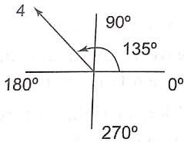
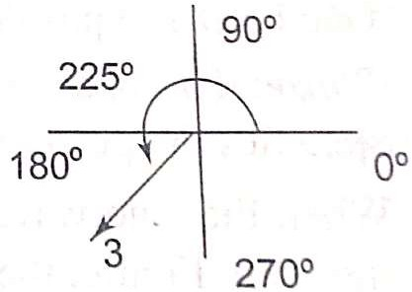
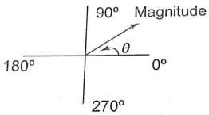
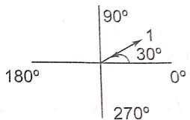
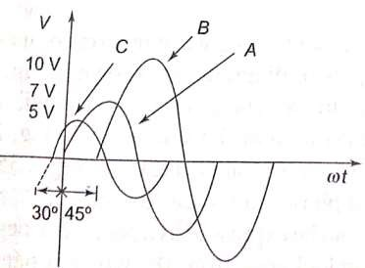
Concept of Phase angle and Phase difference
A phasor diagram can be used to represent a sine wave in terms of its magnitude and angular position.
The length of the arrow represents the magnitude of the sine wave and angle θ represents the angular position of the sine wave.
1∠θ
1∠30⁰
4∠135⁰
3∠225⁰
vA(t) = 7 sin(ω t)
vB(t) = 10 sin(ω t−45⁰)
vc(t) = 5 sin(ω t+30⁰ )

Slide 7
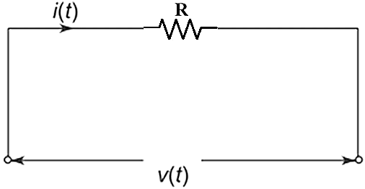
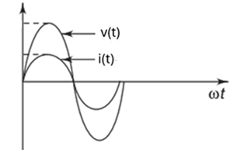
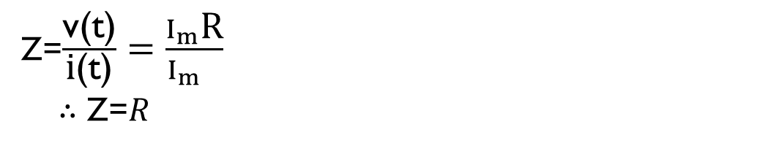
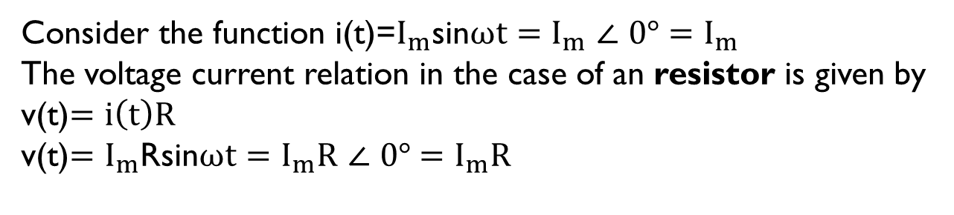
Phasor Relationships for Resistor Element
Consider the function i(t)=$I_{m}$sin$ωt=$ $I_{m}$ $∠$ $0°$ $=$ $I_{m}$
The voltage current relation in the case of an resistor is given by
v(t)$=i\left(t\right)R$
v(t)${=I}_{m}$Rsin$ωt=I_{m}\text{R} ∠ 0°$ $=I_{m}\text{R}$
Z=$\frac{\text{v}\text{(}\text{t}\text{)}}{\text{i}\text{(}\text{t}\text{)}}=\frac{I_{m}\text{R}}{I_{m} }$
$∴$ Z=$R$
Voltage wave form follows current wave form. Voltage and current phasor and current phasor are in phase.

Slide 8
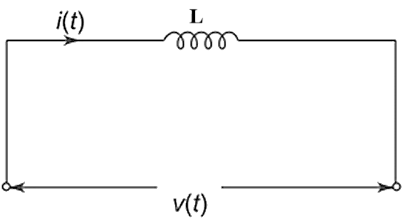
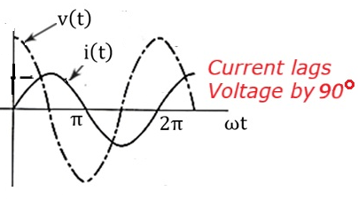
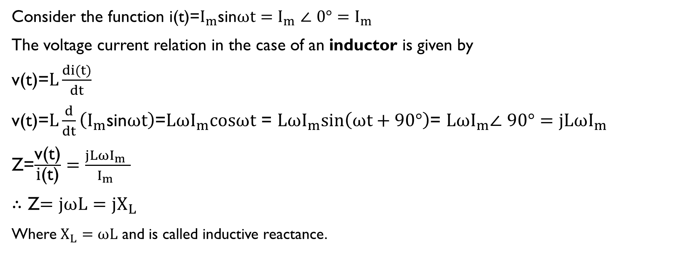

Phasor Relationships for Inductor Element
Consider the function i(t)=$I_{m}$sin$ωt=$ $I_{m}$ $∠$ $0°=I_{m}$
The voltage current relation in the case of an inductor is given by
v(t)=$L\frac{di(t)}{dt}$
v(t)=$L\frac{d}{dt}\left(I_{m}\text{sin}ωt\right)$=$LωI_{m}\text{c}osωt$= $LωI_{m}sin\left(ωt+90°\right)$= $LωI_{m}∠$ $90°=jLωI_{m}$
Z=$\frac{\text{v}\text{(}\text{t}\text{)}}{\text{i}\text{(}\text{t}\text{)}}=\frac{jLωI_{m} }{I_{m} }$
$∴$ Z$=jωL=jX_{L}$
Where $X_{L}=ωL$ and is called inductive reactance.
$Cosωt$= sin$\left(ωt+90°\right)$
The current lags behind the voltage by 90°.
i.e., voltage and current are out of phase.

Slide 9
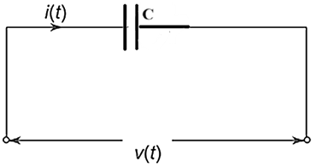
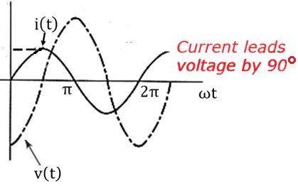
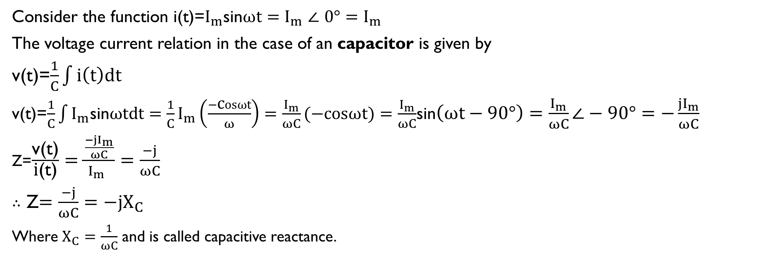
Phasor Relationships for Capacitor Element
Consider the function i(t)=$I_{m}$sin$ωt=$ $I_{m}$ $∠$ $0°=I_{m}$
The voltage current relation in the case of an capacitor is given by
v(t)=$\frac{1}{C}\int{i\left(t\right)dt}$
v(t)=$\frac{1}{C}\int{I_{m}\text{sin}ωtdt}=\frac{1}{C}I_{m}\left(\frac{−\text{c}osωt}{ω}\right)=\frac{I_{m}}{ωC}(−\text{c}osωt)=\frac{I_{m}}{ωC}$sin$\left(ωt−90°\right)=\frac{I_{m}}{ωC}∠−90°=−\frac{{jI}_{m}}{ωC}$
Z=$\frac{\text{v}\text{(}\text{t}\text{)}}{\text{i}\text{(}\text{t}\text{)}}=\frac{\frac{{−jI}_{m}}{ωC}}{I_{m} }=\frac{−j}{ωC}$
$∴$ Z$=\frac{−j}{ωC}=−jX_{C}$
Where $X_{C}=\frac{1}{ωC}$ and is called capacitive reactance.
The current leads the voltage by 90°.
i.e., voltage and current are out of phase.

Slide 10

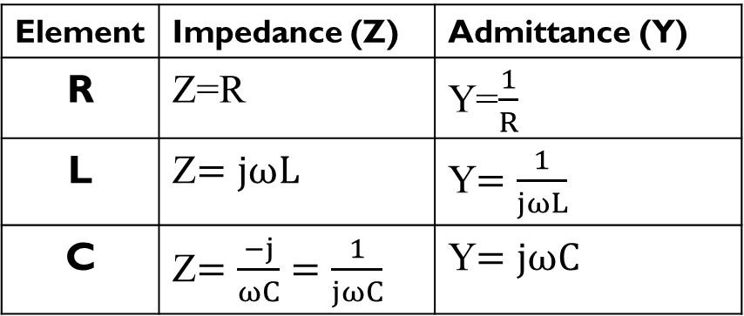
IMPEDANCE AND ADMITTANCE IN R, L, C
Element | Impedance (Z) | Admittance (Y)
R | Z=R | Y=$\frac{1}{R}$
L | Z$=jωL$ | Y$=\frac{1}{jωL}$
C | Z$=\frac{−j}{ωC}=\frac{1}{jωC}$ | Y$=jωC$
The admittance Y is the reciprocal of impedance, measured in siemens (S).

Slide 11
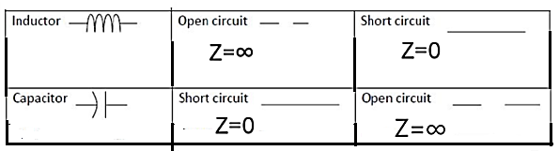
Behavior of Inductor & Capacitor at “0” and “∞” frequencies
We usually take, Frequency (ω) is 0 for DC. Frequency (ω) is ∞ at high frequencies for AC.
AC | DC
Inductor
Z = jωL = ∞ at “∞” frequency;
Z = jωL = 0 at “0” frequency
Capacitor
Z = ^{− j} = 0
at “∞” frequency;
Z = ^{− j} = ∞
at “0” frequency
ωC
ωC

Slide 12
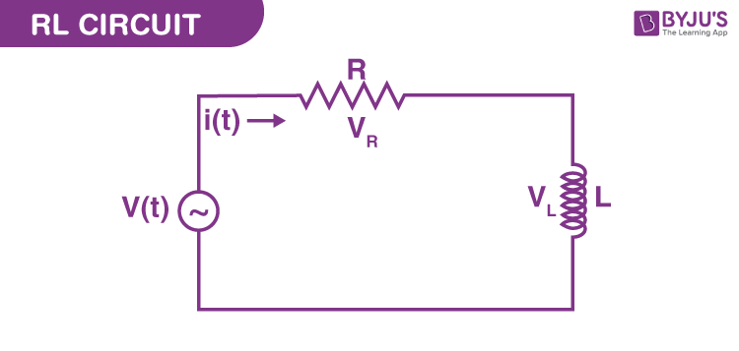
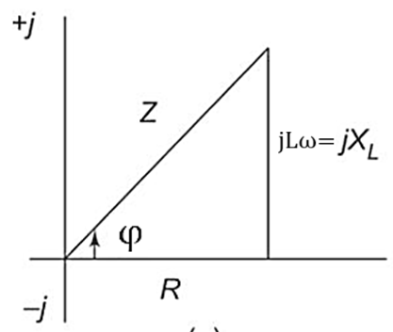

Steady state analysis of RL Series Circuit
Consider the function i(t)=$I_{m}$sin$ωt= I_{m} ∠ 0°=$ $I_{m}$
The voltage current relation in the case of a resistor is given by
$V_{R}=i\left(t\right)R=I_{m}$Rsin$ωt=I_{m}\text{R} ∠ 0°=I_{m}\text{R}$
The voltage current relation in the case of an inductor is given by
$V_{L}$=$L\frac{di(t)}{dt}=L\frac{d}{dt}\left(I_{m}\text{sin}ωt\right)$=$LωI_{m}\text{c}osωt$= $LωI_{m}$sin$\left(ωt+90°\right)$= $LωI_{m}∠$ $90°=jLωI_{m}$
V(t)= $V_{R}+V_{L}$=$I_{m}\text{R}\text{+}jLωI_{m}=I_{m}$($\text{R}\text{+}jLω$)
Z=$\frac{\text{V}\text{(}\text{t}\text{)}}{\text{i}\text{(}\text{t}\text{)}}=\frac{I_{m}\text{(}\text{R}\text{+}jLω\text{)}}{I_{m} }=\text{(}\text{R}\text{+}jLω\text{)}$
$$\text{The} \text{magnitude} \text{of} \text{impedance} \text{for} \text{an} \text{RL} \text{series} \text{circuit} \text{is}$$
$$\text{given} \text{by}$$
$$\left|Z\right|=\sqrt{R^{2}+{\left(Lω\right)}^{2}}$$
The phase angle for an RL circuit is
$$φ=\tan^{−1}\left(\frac{Lω}{R}\right)$$
The current lags behind the voltage by 90°. i.e., voltage and current are out of phase.

Slide 13
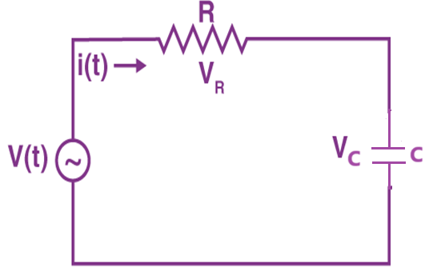
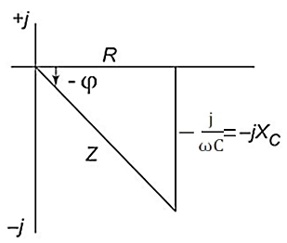

Steady state analysis of RC Series Circuit
Consider the function i(t)=$I_{m}$sin$ωt= I_{m} ∠ 0°=$ $I_{m}$
The voltage current relation in the case of a resistor is given by
$V_{R}=i\left(t\right)R=I_{m}$Rsin$ωt=I_{m}\text{R} ∠ 0°=I_{m}\text{R}$
The voltage-current relation in the case of a capacitor is given by
$$V_{C}=\frac{1}{C}\int{i\left(t\right)dt}=\frac{1}{C}\int{I_{m}\text{sin}ωtdt}=\frac{1}{C}I_{m}\left(\frac{−\text{c}osωt}{ω}\right)=\frac{I_{m}}{ωC}(−\text{c}osωt)=\frac{I_{m}}{ωC}sin\left(ωt−90°\right)=\frac{I_{m}}{ωC}∠−90°=−\frac{{jI}_{m}}{ωC}$$
V(t)= $V_{R}+V_{C}$=$I_{m}\text{R}−\frac{{jI}_{m}}{ωC}=I_{m}$($\text{R}−\frac{j}{ωC}$)
Z=$\frac{\text{V}\text{(}\text{t}\text{)}}{\text{i}\text{(}\text{t}\text{)}}=\frac{I_{m}\text{(}\text{R}−\frac{j}{ωC}\text{) }}{I_{m} }=\text{(}\text{R}−\frac{j}{ωC}\text{)}$
$$\text{The} \text{magnitude} \text{of} \text{impedance} \text{for} \text{an} \text{R}\text{C} \text{series} \text{circuit} \text{is}$$
$$\text{given} \text{by}$$
$$\left|Z\right|=\sqrt{R^{2}+{\left(\frac{1}{ωC}\right)}^{2}}$$
The phase angle for an RC circuit is
$φ=\tan^{−1}\left(\frac{− \frac{1}{ωC}}{R}\right)$= ${−tan}^{−1}\left(\frac{1}{RωC}\right)$
The current leads the voltage by 90°. i.e., voltage and current are out of phase.

Slide 14
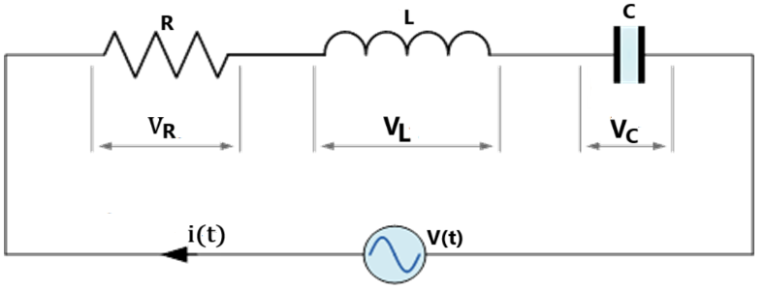
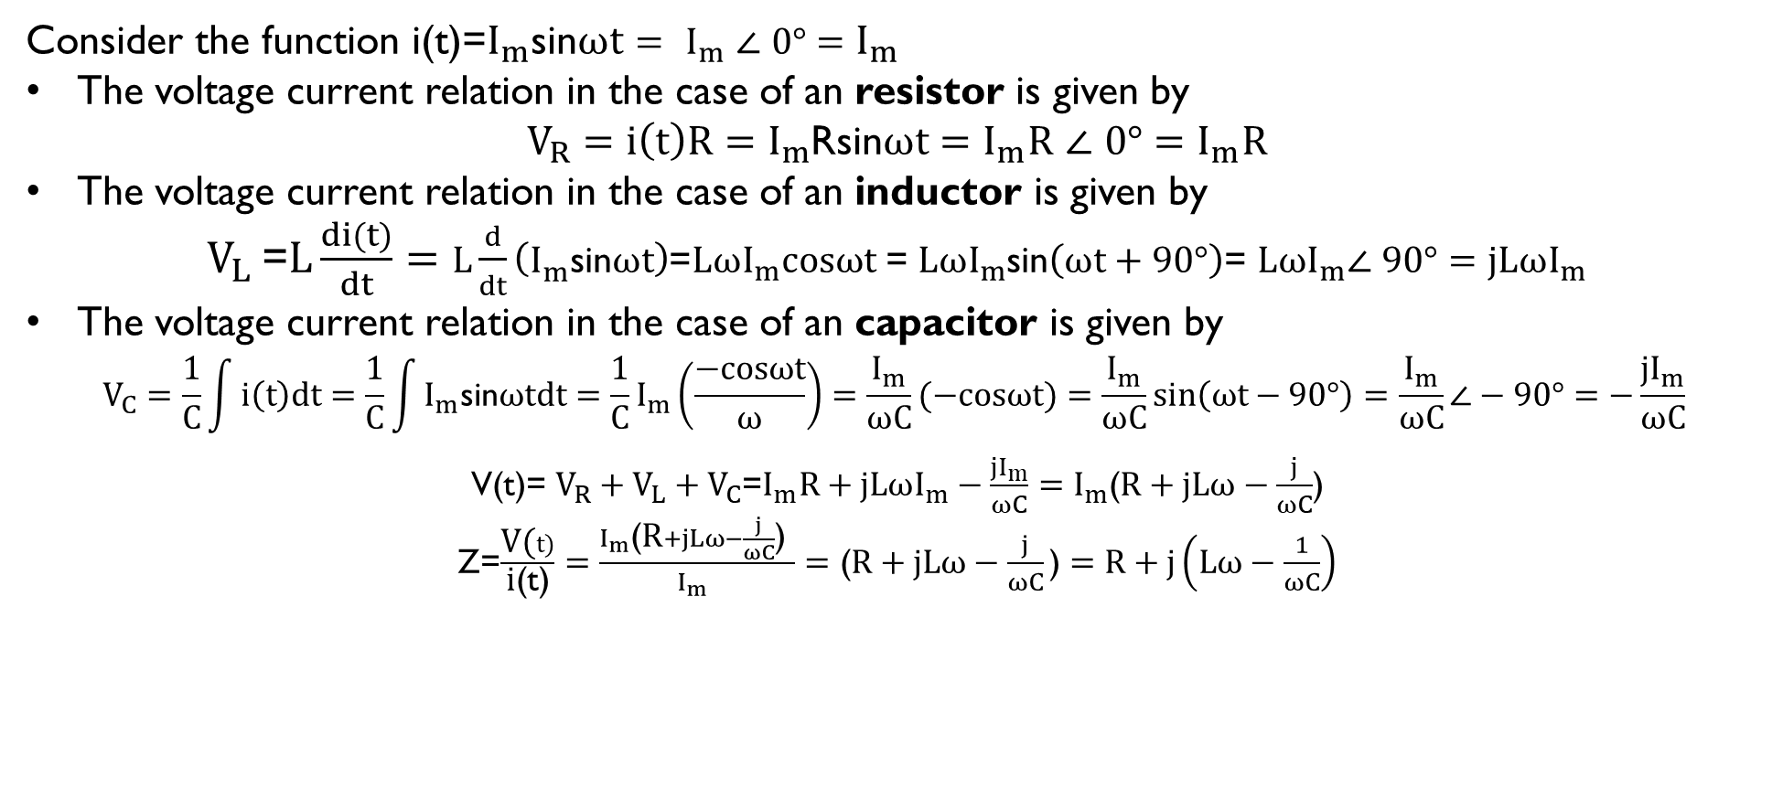
Steady state analysis of RLC Series Circuit
Consider the function i(t)=$I_{m}$sin$ωt= I_{m} ∠ 0°=$ $I_{m}$
The voltage current relation in the case of an resistor is given by
$V_{R}=i\left(t\right)R=I_{m}$Rsin$ωt=I_{m}\text{R} ∠ 0°=I_{m}\text{R}$
The voltage current relation in the case of an inductor is given by
$V_{L}$=$L\frac{di(t)}{dt}=L\frac{d}{dt}\left(I_{m}\text{sin}ωt\right)$=$LωI_{m}\text{c}osωt$= $LωI_{m}$sin$\left(ωt+90°\right)$= $LωI_{m}∠$ $90°=jLωI_{m}$
The voltage current relation in the case of an capacitor is given by
$$V_{C}=\frac{1}{C}\int{i\left(t\right)dt}=\frac{1}{C}\int{I_{m}\text{sin}ωtdt}=\frac{1}{C}I_{m}\left(\frac{−\text{c}osωt}{ω}\right)=\frac{I_{m}}{ωC}(−\text{c}osωt)=\frac{I_{m}}{ωC}sin\left(ωt−90°\right)=\frac{I_{m}}{ωC}∠−90°=−\frac{{jI}_{m}}{ωC}$$
V(t)= $V_{R}+V_{L}+V_{C}$=$I_{m}\text{R}+jLωI_{m}−\frac{{jI}_{m}}{ωC}=I_{m}$($\text{R}+jLω−\frac{j}{ωC}$)
Z=$\frac{\text{V}\text{(}t)}{\text{i}\text{(}\text{t}\text{)}}=\frac{I_{m}\text{(}\text{R}+jLω−\frac{j}{ωC}\text{) }}{I_{m} }=\text{(}\text{R}+jLω−\frac{j}{ωC}\text{)}$ $=\text{R}+j\left(Lω−\frac{1}{ωC}\right)$

Slide 15
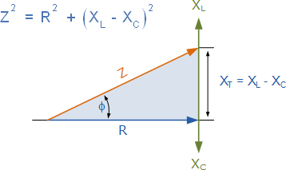

Steady state analysis of RLC Series Circuit
$$\text{The} \text{magnitude} \text{of} \text{impedance} \text{for} \text{an} \text{R}\text{LC} \text{series}$$
$$\text{circuit} \text{is} \text{given} \text{by}$$
$$\left|Z\right|=\sqrt{R^{2}+{\left(Lω−\frac{1}{ωC}\right)}^{2}}$$
The phase angle for an RLC circuit is
$$φ=\tan^{−1}\left(\frac{Lω−\frac{1}{ωC}}{R}\right)$$
Inductor current lags the voltage by 90º.
Capacitor current leads the voltage by 90º.

Slide 16
SELF-ASSESSMENT QUESTIONS
1. What type of power represents the actual energy used to perform work in an electrical circuit (B)
A) Apparent power
B) True power
C) Reactive power
D) Complex power
Which unit is used to measure apparent power in an electrical circuit (B)
A) Watts (W)
B) Volt-amperes (VA)
C) Volt-amperes reactive (VAR)
D) Amperes (A)

Slide 17
SELF-ASSESSMENT QUESTIONS
3. Reactive power in an AC circuit is primarily associated with: (B)
A) Energy consumption
B) Magnetic and electric fields
C) Useful work output
D) Current flow
4. The combination of true power and reactive power in an AC circuit gives rise to: (A)
A) Apparent power
B) Complex power
C) Active power
D) Reactive power

Slide 18
SELF-ASSESSMENT QUESTIONS
5. In an RLC circuit, what does "R" represent?
Resistor
Reactance
Resonance
Real power
6. In which of the following circuit, current lags voltage?
RC
RL
Both
None

Slide 19
SELF-ASSESSMENT QUESTIONS
7. What is the Phase angle of Voltage across Resistor?
90 degrees
-90 degrees
Zero degrees
None
8. In which of the following circuit, current leads voltage?
RC
RL
Both
None

Slide 20
TERMINAL QUESTIONS
Define true power, apparent power, reactive power, power factor.
Differentiate between apparent power and reactive power, emphasizing their individual contributions in AC circuits.
Describe the relation between voltage and current of RL Series circuit.
Describe the relation between voltage and current of RC Series circuit.
Describe the relation between voltage and current of RLC Series circuit.

Slide 21
REFERENCES FOR FURTHER LEARNING OF THE SESSION
Reference Books:
1. Analysis and Synthesis A Sudhakar, Shyam Mohan S PallI, ed, TMH
Sites and Web links:
https://control.com/technical-articles/active-power-reactive-power-apparent-power-and-the-role-of-power-factor/
https://www.electronics-tutorials.ws/accircuits/series-circuit.html
https://www.electrical4u.com/rlc-circuit/

Slide 22
THANK YOU
Team – BASIC ELECTRICAL & ELCTRONIC CIRCUITS (BEC)

